Slide 1
Scientific Writing
and
The World of Publishing
Kyle Dexter
kyle.dexter@ed.ac.uk

Slide 2

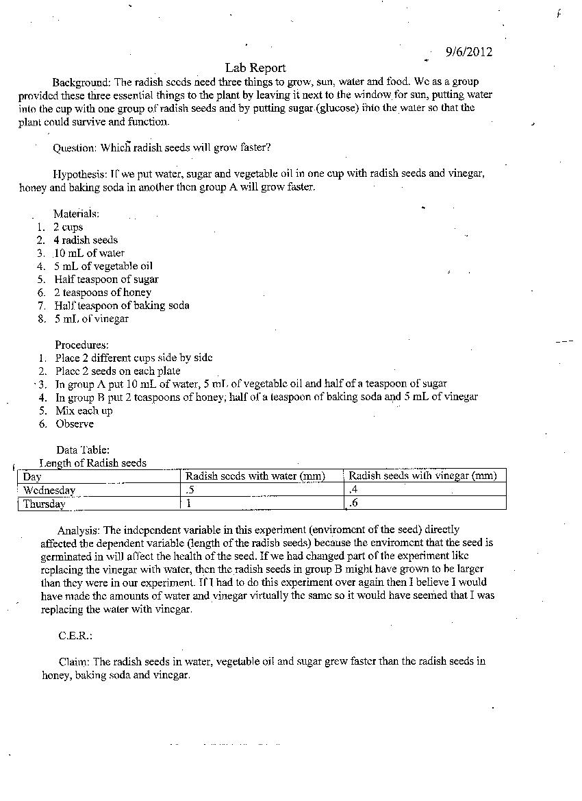
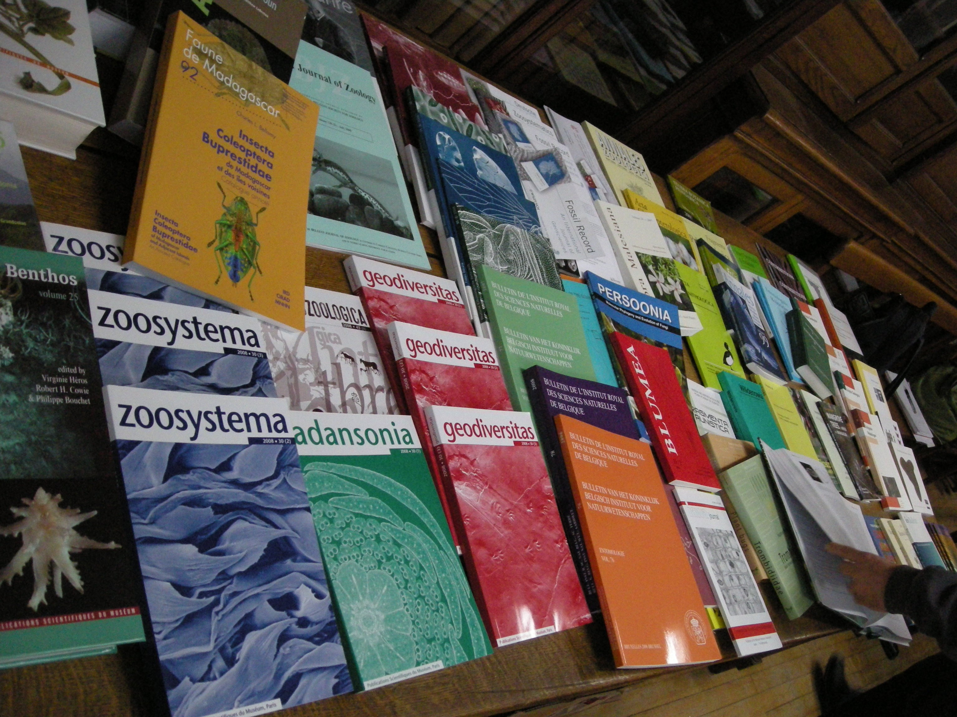
Examples of Scientific Writing

Slide 3
Outline for Today
General principles of scientific writing
Structure of a scientific document
More specifics about journal articles
Overview of scientific literature, citation metrics, etc.

Slide 4
In the Beginning…
“Don't get it right, just get it written”
-James Thurber, American humourist
The biggest hurdle to overcome in any writing is the blank page.
Don’t be a perfectionist, just get started!

Slide 5

The Golden Thread
Every scientific document should have a central point or main theme.
Everything in the document should be related to that central point.
This can be thought of as the golden thread, that should run through the entire document.

Slide 6

But My Aims Were…
“Not what you did or what you learned, but what you want your audience to understand” Turbek et al. 2016. Bull. ESA
You cannot include everything you did. Only include the methods and results relevant to the golden thread.

Slide 7

Style
Concise!! This is often an issue for non-native English speakers.
Generally avoid colloquial or informal language.
Use appropriate terminology, certain terms have certain meanings.
Define jargon and acronyms.
What about passive voice?
Need to be understandable to be read.

Slide 8

There Will Be Many Drafts
Don’t be a perfectionist. Initial drafts are not expected to be good.
Be prepared for many edits and drafts, particularly the more authors/supervisors there are.
When you think you have a final draft, you don’t.

Slide 9
A Picture is Worth a Thousand Words

Slide 10
Outline for Today
General principles of scientific writing
Structure of a scientific document
More specifics about journal articles

Slide 11
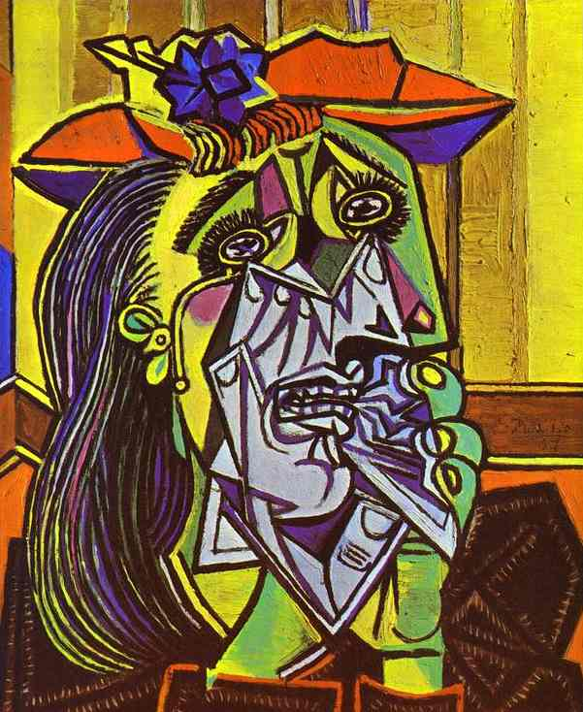
The Abstract
This is the only part of a paper or thesis that most people will ever read.
So, spend a lot of time on this.
Every word counts!
This should be a summary of the whole paper, not just the aims.

Slide 12
Abstract checklist
Motivation: why do we care about this topic?
The gap: what problem have you solved / are trying to solve?
Methods: how did you solve the problem or make progress on it?
Results: what did you find?
Conclusions: what are the implications of this work?

Slide 13

Introduction
Go from very general to specific.
The first and last paragraphs are critical.
You have to convince the reader that what you are studying is of the highest importance and that the approach you took to study it is the BEST way to do it.
Think of this as a sales pitch. You are selling your research.

Slide 14

Materials and Methods
To repeat, only include things that you did which are relevant to the golden thread.
Concision can be a struggle here, even while you try and ensure reproducibility.
Common sections include
study site/species,
field/laboratory work,
data/statistical analysis

Slide 15
Results: Figures
Major results should be presented visually. Most readers will only look at the abstract and figures.
Be prepared to spend a lot of time on these.
Common to include a map of study area with inset for overall location.
Minimize white space

Slide 16
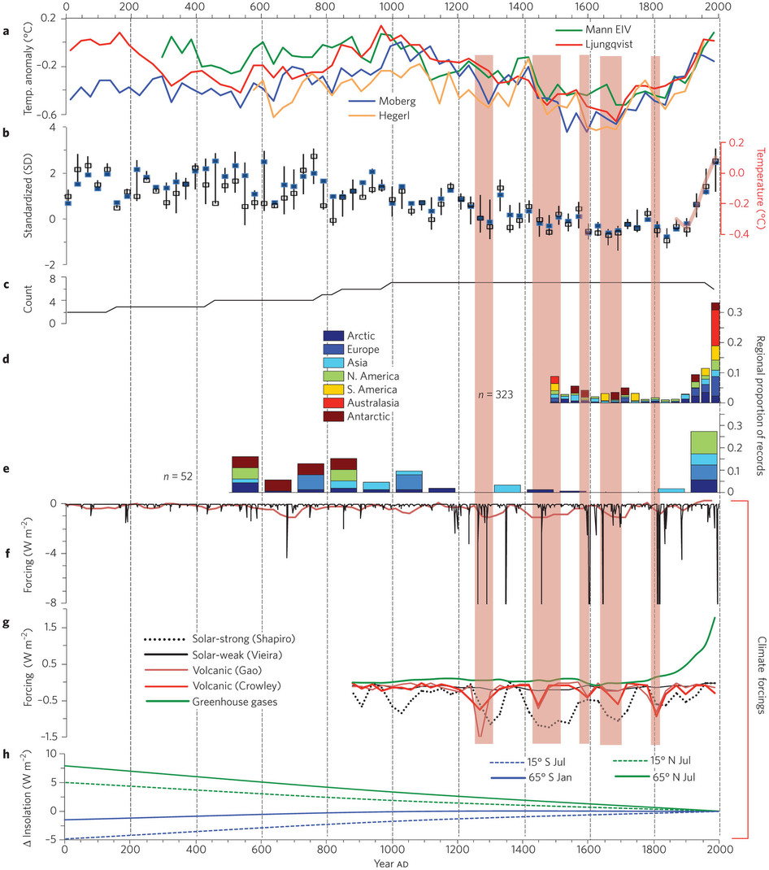
A Picture is Worth a Thousand Words

Slide 17
Figures checklist
Every figure in a paper must be:
necessary
legible (resolution, font size)
referred to in the text
numbered
and must have:
labelled axes, with units
an explanatory caption
carefully chosen colour (colour-blind friendly)

Slide 18
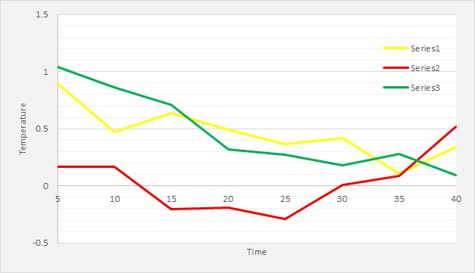
Can you improve this figure?

Slide 19
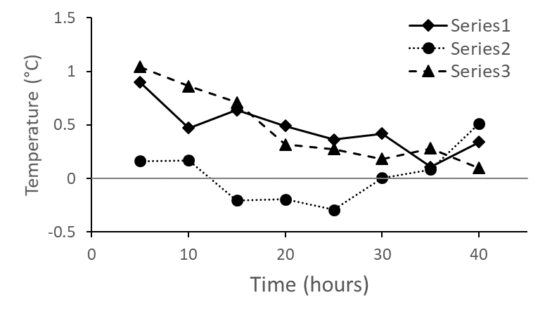
Can you improve this figure?

Slide 20
Results: Tables
Tables for summary statistics of sites, species, or sample units.
Don’t be shy about bolding text in tables.
Use abbreviations to make column headers smaller.

Slide 21
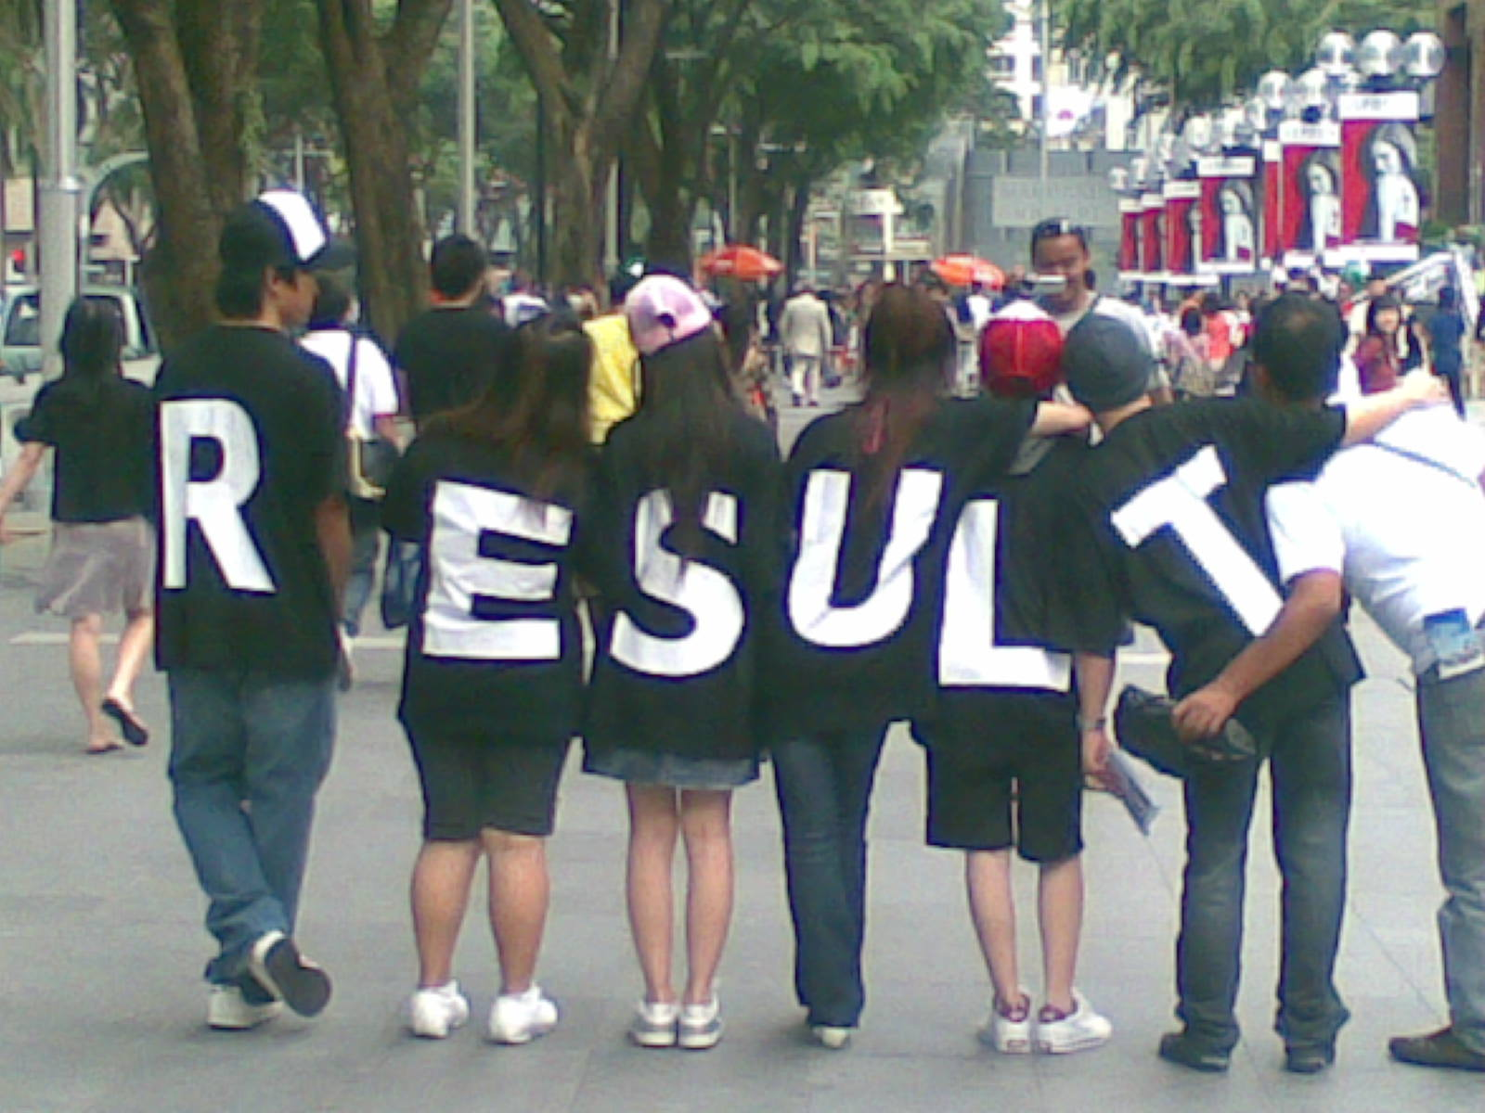
Results: Text
Start general. E.g. we found X number of species or installed plots at X number of sites.
Follow the same order as the methods, as the tables and figures, and the aims if possible.
Others suggest leading with most important result.
Text can actually be quite minimal
Text will include some repetition of information in the tables and figures. Highlight major results in text.

Slide 22

Discussion
Start on a positive note, rehash most significant result(s) and why important. Connect back to last paragraph of Intro.
Then go through results in more detail.
Place your results in the context of the literature while being positive about others’ research.
Caveats and problems should not be ignored, but they should not receive emphasis.
Conclusions should not be a repeat of the beginning of the discussion, rather focus on broader implications.

Slide 23

Acknowledgements
People deserve to be acknowledged. Don’t forget anyone.
Funders should be acknowledged, (NERC grant NE/L002558/1 for E3/E4 DTP).
You can put whatever you want in a thesis. In a journal article, list only support directly relevant to the research.

Slide 24

References
Every journal seems to have a different format. This is just an unfortunate fact of life.
Nevertheless, we have to get it right. This requires lots of proofreading.

Slide 25
The Actual Order of Writing
Sections | Order in Writing
Title | 1
Abstract | 9
Introduction | 8
Aims (last bit of introduction) | 2
Methods | 4
Results (tables and figures) | 3
Results (text) | 5
Discussion | 6
Conclusions | 7
Acknowledgements | 11
References | 10

Slide 26
Outline for Today
General principles of scientific writing
Structure of a scientific document
More specifics about journal articles

Slide 27

Why Publish?
Why did you do the research in the first place if not to publish it?
If your work is funded by taxpayer dollars, you are under some obligation to publish.
For academics, lot of truth to the statement “Publish or Perish.”

Slide 28
How to Choose a Journal?
Think about your golden thread, and where it belongs.
Read the journal’s website and their ‘mission statement’.
Read other papers in the journal to see if yours is appropriate.
If you are intent on academic success, do check out impact factors.

Slide 29
Submission checklist
read the journal’s author guidelines (again)
article processing charges
agreement of co-authors
data / code availability
proofreading (ask someone else)
references are accurate, complete and correctly formatted
figure and table formats
is a cover letter required?
are reviewer suggestions invited / required?
copyright transfer (later on…)
add your ORCID (https://orcid.org/)

Slide 30
The Cover Letter
Dear Editor Jane,
It is my pleasure to submit this article on toe fungus to the journal of “Toe Fungology”. This is the most amazing piece of science that you will ever read and it will fundamentally change the world as we know it.
Sincerely,
Joe

Slide 31

Suggested Referees

Slide 32
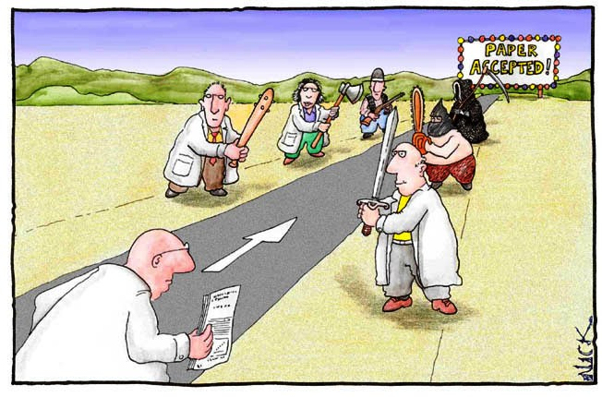
After Submission
Don’t be disheartened by rejection. It is not worthwhile.
Reviewers are generally trying to help.
Remember that, in all likelihood, the paper will go back to the original reviewers. Address their comments and be positive.

Slide 33
Response checklist
cover letter to the editor
summary of each review (optional)
list and respond to every review comment
you can disagree, but be respectful!
does the reviewer deserve an acknowledgment?

Slide 34
Additional Reading on Writing
The 5 pivotal paragraphs in a paper – Dynamic Ecology https://dynamicecology.wordpress.com/2016/02/24/the-5-pivotal-paragraphs-in-a-paper/
JC Cahill’s “Finding the “Pitch” in Ecological Writing” http://onlinelibrary.wiley.com/doi/10.1890/0012-9623-92.2.196/full
The Science of Scientific Writing (Gopen and Swan)
https://home.gwu.edu/~jcmarsh/wiki/uploads/Research/Science_of_Scientific_Writing.pdf

Slide 35
Reviewer checklist
does the manuscript fall within your area of expertise?
do you have any conflicts of interest?
do you have time?
Ask yourself:
do I understand the paper?
do I believe the results and conclusions?
do I care?
Report:
brief summary
major comments
minor comments / corrections
overall recommendation
Last step, read the review aloud!

Slide 36
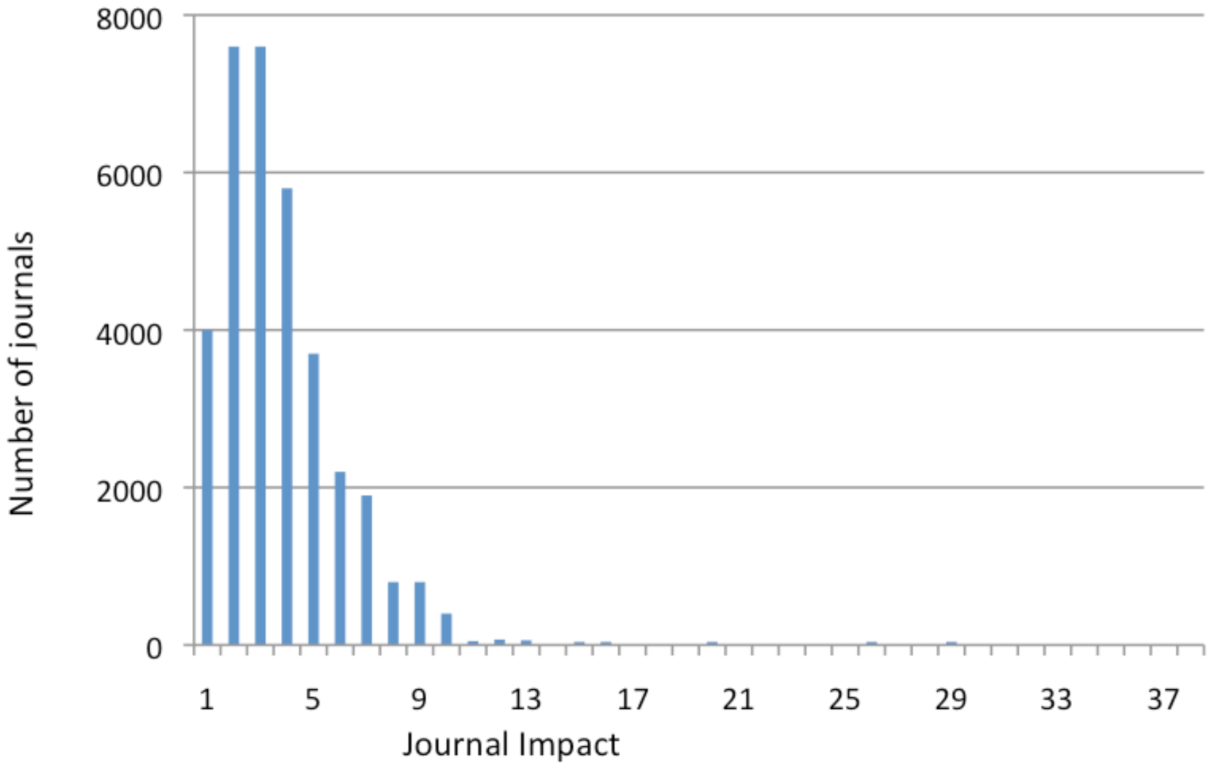
Other Miscellaneous Thoughts
Impact factors
H-Indices and other citation metrics
Open access versus not
Predatory journals
Special issues
The ever-evolving publishing landscape
Gargouri et al. 2010. PLoS One

Slide 37
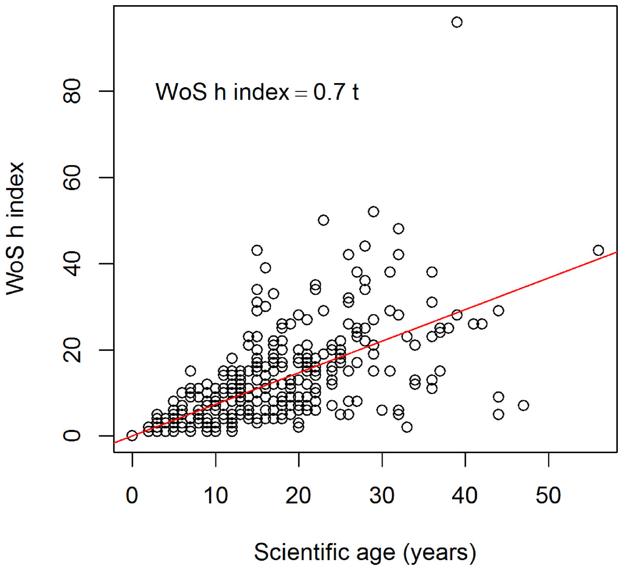
Other Miscellaneous Thoughts
Impact factors
H-Indices and other citation metrics
Open access versus not
Predatory journals
Special issues
The ever-evolving publishing landscape
Minasni et al. 2013. PeerJ

Slide 38
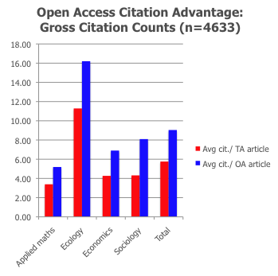
Other Miscellaneous Thoughts
Impact factors
H-Indices and other citation metrics
Open access versus not
Predatory journals
Special issues
The ever-evolving publishing landscape
Norris et al. 2008. J Amer Soc Info Sci Tech

Slide 39
Other Miscellaneous Thoughts
Impact factors
H-Indices and other citation metrics
Open access versus not
Predatory journals
Special issues
The ever-evolving publishing landscape

Slide 40
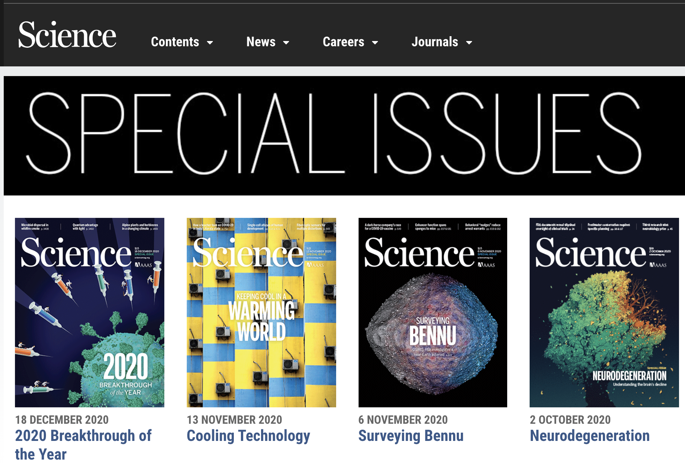
Other Miscellaneous Thoughts
Impact factors
H-Indices and other citation metrics
Open access versus not
Predatory journals
Special issues
The ever-evolving publishing landscape

Slide 41

Other Miscellaneous Thoughts
Impact factors
H-Indices and other citation metrics
Open access versus not
Predatory journals
Special issues
The ever-evolving publishing landscape
https://uconnlibrary.wordpress.com/

